Slide 1

Module One: The Role of Technology
CIS 303 – Prof. C. R. Johnson

Slide 2

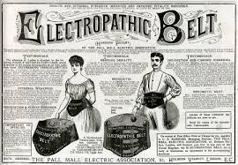
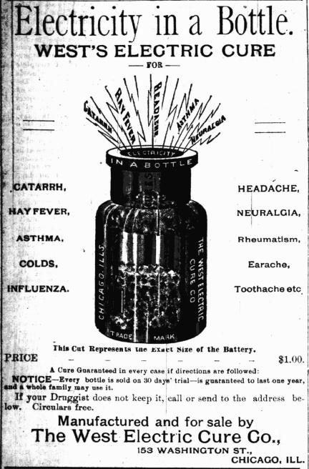

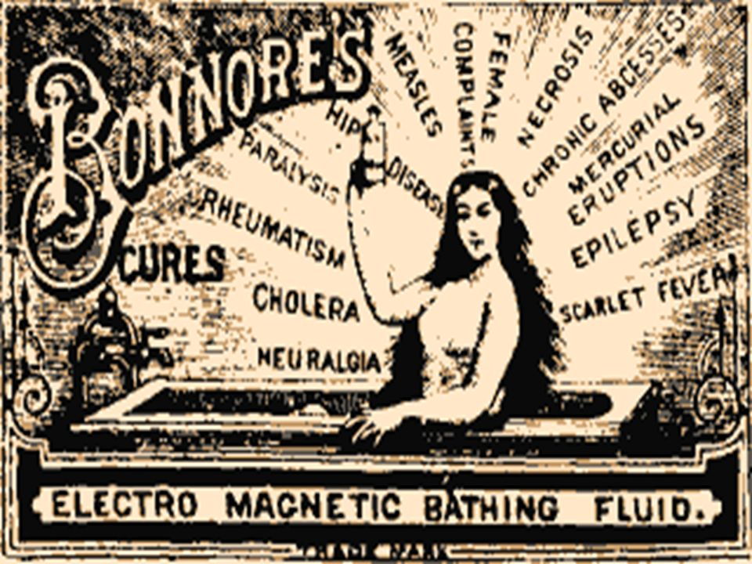

Slide 3





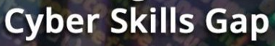

Slide 4
The role of technology in society
Necessity is the mother of invention. All technology exists to solve a problem.
Technology allows human work to focus on the creative and cognitive. We produce the ideas; technology executes the rest. We think, therefore it is.
That problem always comes down to supporting, supplementing, or enhancing human work.

Slide 5
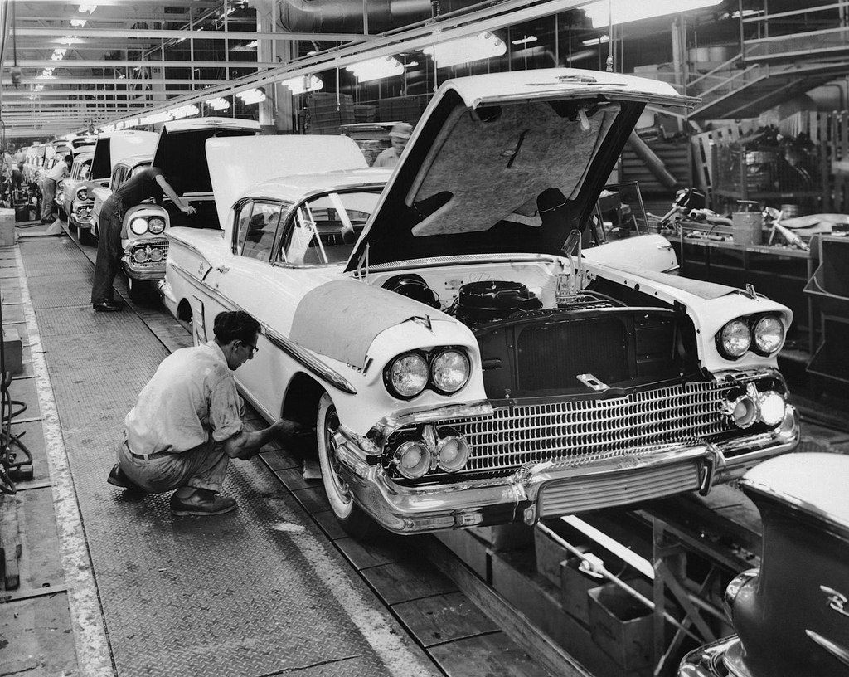
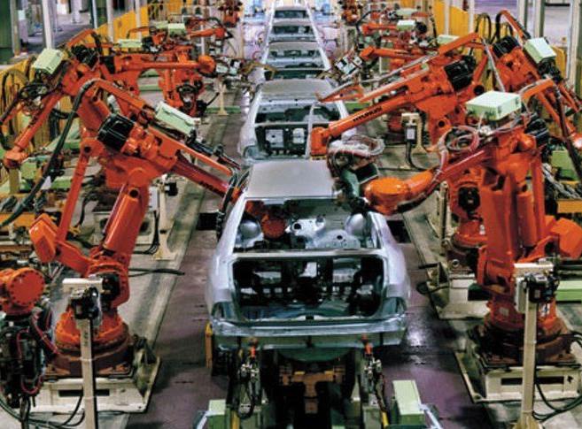
What does it mean – technology “supports” our lives?
Technology improves efficiency of human work.
What does it mean – technology “supplements” our lives?
Technology replaces human work, taking humans out of the equation.
What does it mean – technology “enhances” our lives?
Technology allows humans to do work that would otherwise be impossible.
Notes:
What does it mean – technology “supports” our lives?
Consider designing a car. Technology makes the process from design to purchase more efficient.
What does it mean – technology “supplements” our lives?
Consider that car… Robots assemble it. Computers provide crash-avoidance, auto-pilot, etc.
What does it mean – technology “enhances” our lives?
Back to the car… Back-up cameras, GPS, etc.

Slide 6
Tech Grows up
Technology can do more than one of those at a time.
Technology’s role can change over time.
Society can change, rendering certain technologies obsolete without a technological advancement to replace it.

Slide 7


You Are Here
Today, most technology supports and enhances human lives, but the expansion of supplementing is happening.

Slide 8
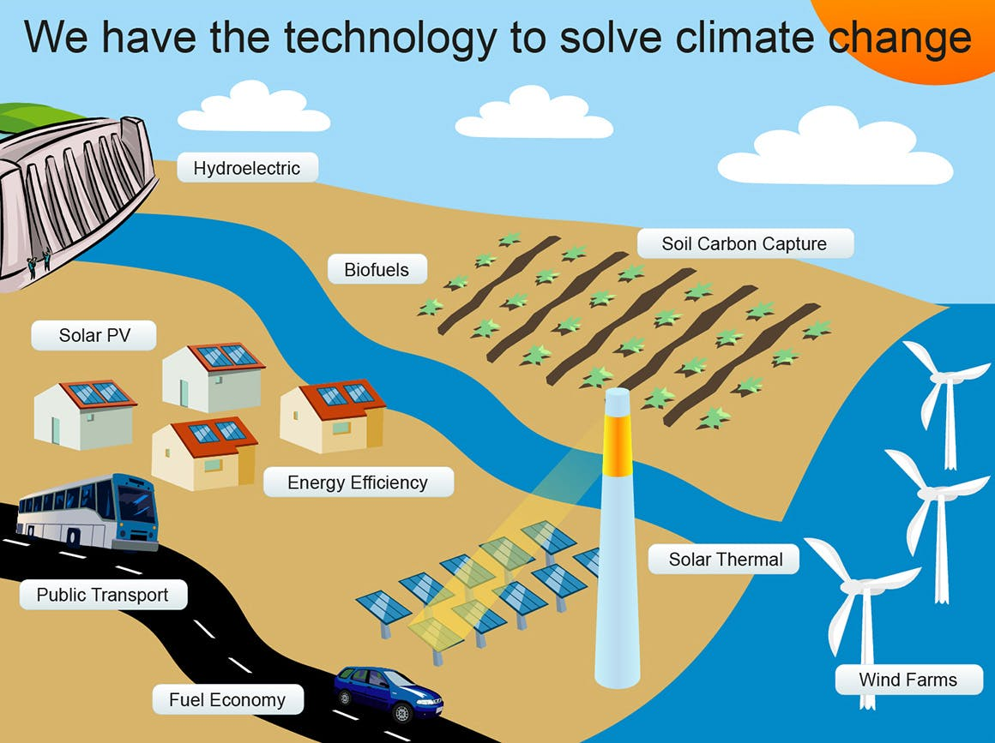
Technology as Savior
In short – we use technology to solve problems.
Even problems created by technology.

Slide 9
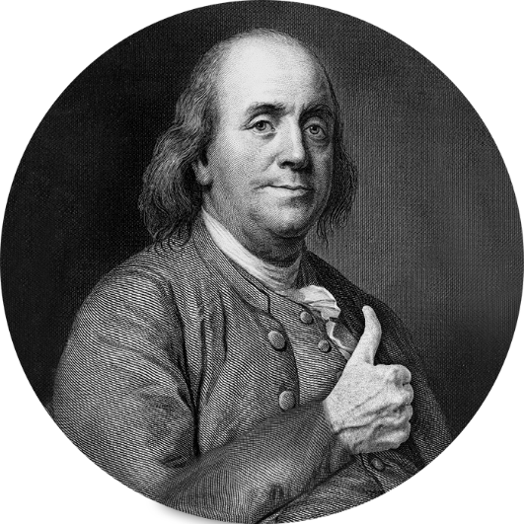
What problem does modern tech solve?
Computers – Easy. It’s in the name. They compute.
They also do other things humans are bad at, like storing information and recalling it exactly (we hope.)
Internet – Harder…
What good is a newborn baby?

Slide 10




Slide 12


Slide 13



Slide 14


Slide 15
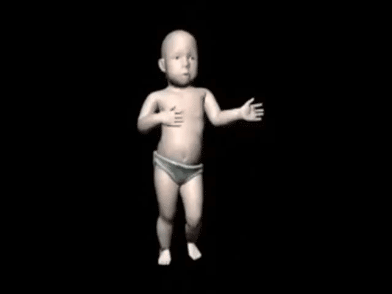

Slide 16



Slide 17
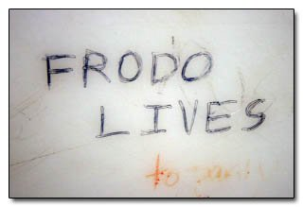

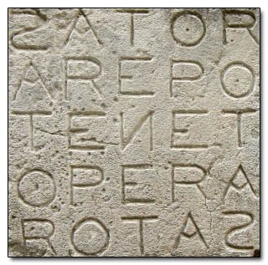
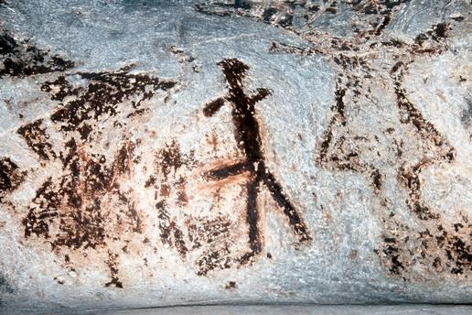
Okay?

Slide 18
Wise men speak because they have something to say; Fools because they have to say something.
Communication
Lower transaction cost.
Date displacement.
Facilitation / Publishing authority
We use our ability to communicate in many ways.

Slide 19

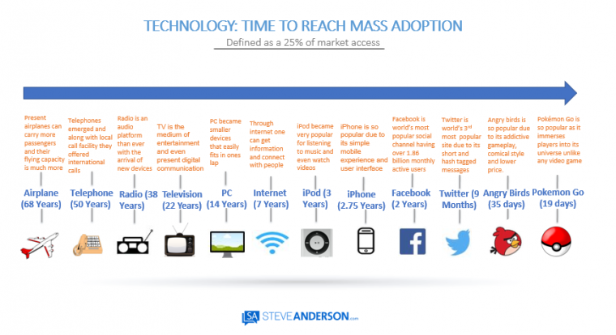
Communication
Human speech ~2 MYA
Written word ~3200 BCE
EB - Timeline of Technology

Slide 20
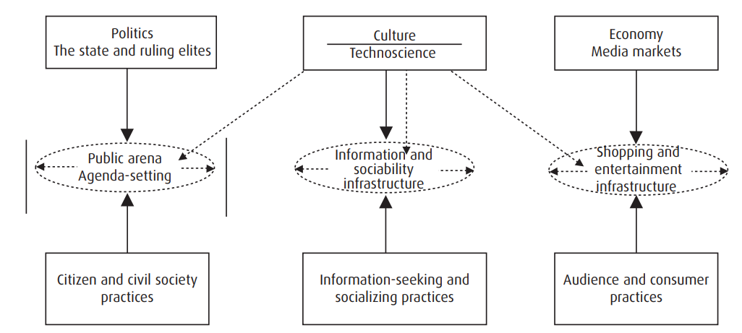
Online IRL

Slide 21
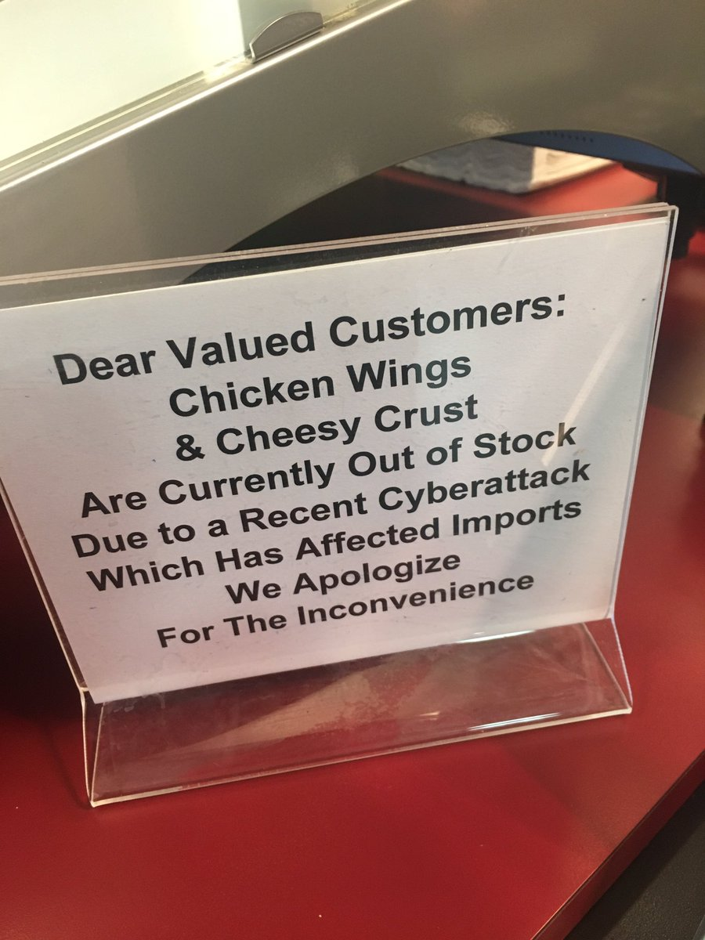
Modern Solutions -> Modern Problems
Improvements in efficiency also improve the efficiency of flaws.
Yellow Journalism -> Clickbait
Era of the Scoop -> Fake news
Bookworms -> Couch Potatoes -> Netheads
Infrastructure disruptions, divorce from process, globalization lofted by technology. Human life dependent on technology.
New ways for bad people to do bad things and good people to do dumb things.
Notes:
People congregate.
This leads to a process of self-selection.
Echo-chambers amplify.
Social issues with the Internet.
Inequality
Change of public and social capital
Venue change of deliberative democracy
Court of public opinion
Identity, culture
Social/mood disorders both as a result and its impact on the above.
Social order / dehumanization

Slide 22
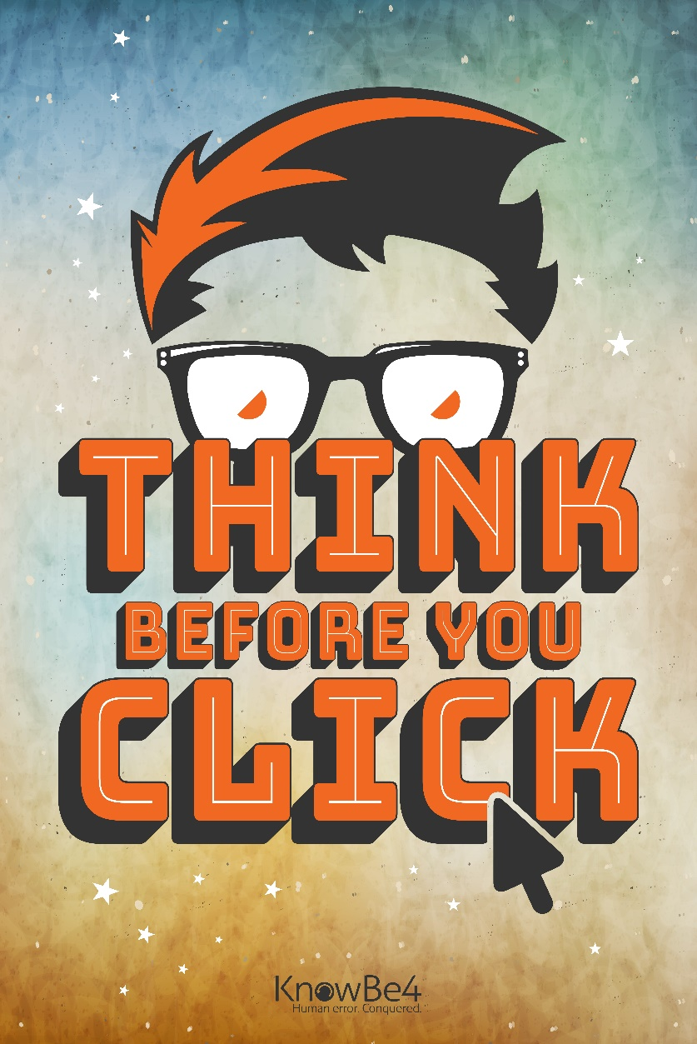
A lot of cyber, not enough social
Security is always ultimately a human problem.
Cybersecurity as a discipline tends to see people as components in a security system.
A cannot patch, but we can teach.
We acknowledge the weakness, but not the problem.
Notes:
We sardonically fill in the blanks follow incidents, answering the question “WHY did they respond to the phish and give away their password” with the least charitable terms.

Slide 23
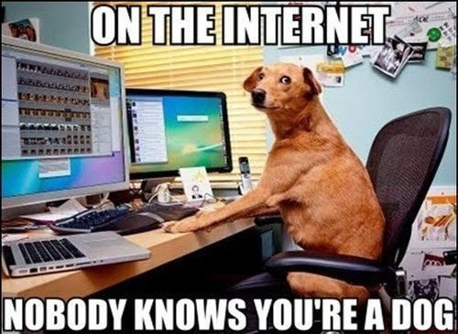
Why training Struggles
Are you outgoing, or shy? Patient, or impatient? Empathetic, or callous?
Behavioral schema - A mental structure internal to us that helps us to organize what we think and guide what we do.
Our behavior within a schema is a persona.
Notes:
Each of us has several schemas. We have a friend schema, a child schema, an employee schema, a buyer schema, a driver schema, and so on.
It is entirely possible for our schemas to have contradictory traits.
If we have no schema for a situation, we experience discomfort and evoke a maladaptive persona.

Slide 24
Which persona are you training?
We can provide training to a “work” persona, but it may not be effective or even applicable in other schemas.
More and more workers are being asked to blend home and work life, leading to security incidents outside of work hours by accident.
The trap for training is to treat it like a work task or compliance checkmark. Methods that cut through existing schemas tends to “stick” better – like gamifying.
Notes:
Each of us has several schemas. We have a friend schema, a child schema, an employee schema, a buyer schema, a driver schema, and so on.
It is entirely possible for our schemas to have contradictory traits.
You need to break through a persona to reprogram it.

Slide 25
Space Transition Theory
Dark Tetrad
Psychopathy
Sadism
Narcissism
Machiavellianism

Slide 26
Space Transition Theory
Persons with repressed criminal behavior have a propensity to commit crime in cyberspace which they would not otherwise commit.
Dark Tetrad traits, suppressed in real life, can manifest themselves when the offender is insulated from the social consequences of their actions.

Slide 27
Space Transition Theory
Social norms are conditions of the social contract. Violation of that contract is reinforced by stigma. Criminal violations are punished by law.
Virtual environments do not make that reinforcement as direct.
Identity flexibility / relative anonymity
Lack of deterrence / oversight
Conflict of norms between deviance IRL vs online. See also: Solipsism Syndrome

Slide 28
Space Transition Theory
Four elements distinguish online interactions from offline interactions.
Anonymity (Pseudonymity)
Permanence
Constant connectivity
Depersonalization/Deindividuation

Slide 29
Lessons of Space Transition Theory
A person’s behavior offline may be different than their behavior online. A person’s nature is revealed in the absence of consequence.
In your environment, maintaining accountability is critical.
It does appear to be possible to perform behavior attribution via stylometry and behavioral analytics (See Kotikalapudi, et al. 2012, Carpenter, et al. 2016) – which may in the future be used to improve intrusion detection through identifying user intent.

